Slide 1
FINAL PLOJECT
栃本 拓海, 野田 遼平, TSAI Chanchang, YE ZHUOBIN

Slide 2
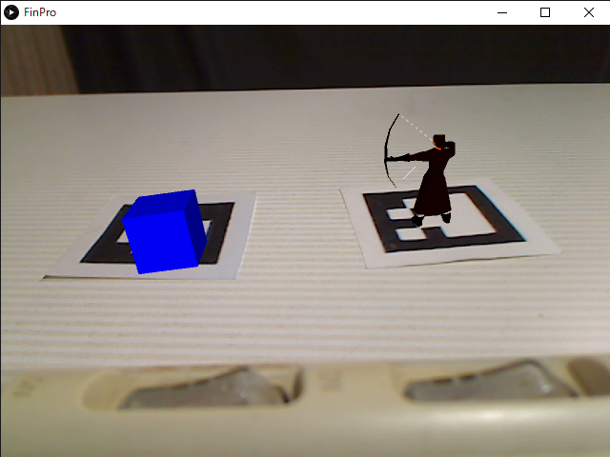
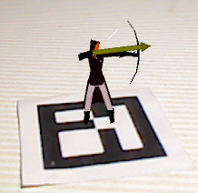
What we made
Archer stands on the marker and shoots an arrow at the target on the marker.
We use multiple markers.

Slide 3

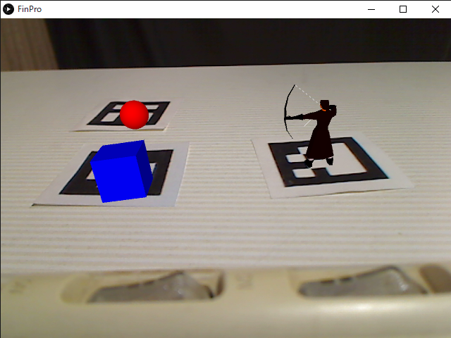
Detail
Case 1 : Number of markers = 1
Case 3 : Number of markers ≧ 3
Show an archer
An archer shoot the cube if sphere is closer than decided distance .
Case 2 : Number of markers = 2
An archer shoot cube if cube is closer than a threshold.

Slide 4
How we made
Processing
models
Archer
Cube
Sphere
Rendering
Pose estimation of marker
Position estimation
Real World

Slide 5
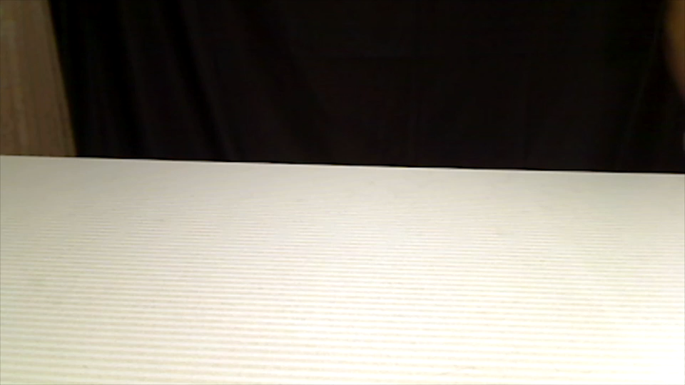
Demonstration

